Slide 1
A First Book of ANSI C Fourth Edition
Chapter 15
A Brief Introduction to C++

Slide 2
Objectives
Procedural Programming in C++
Object-Oriented C++
Common Programming and Compiler Errors

Slide 3
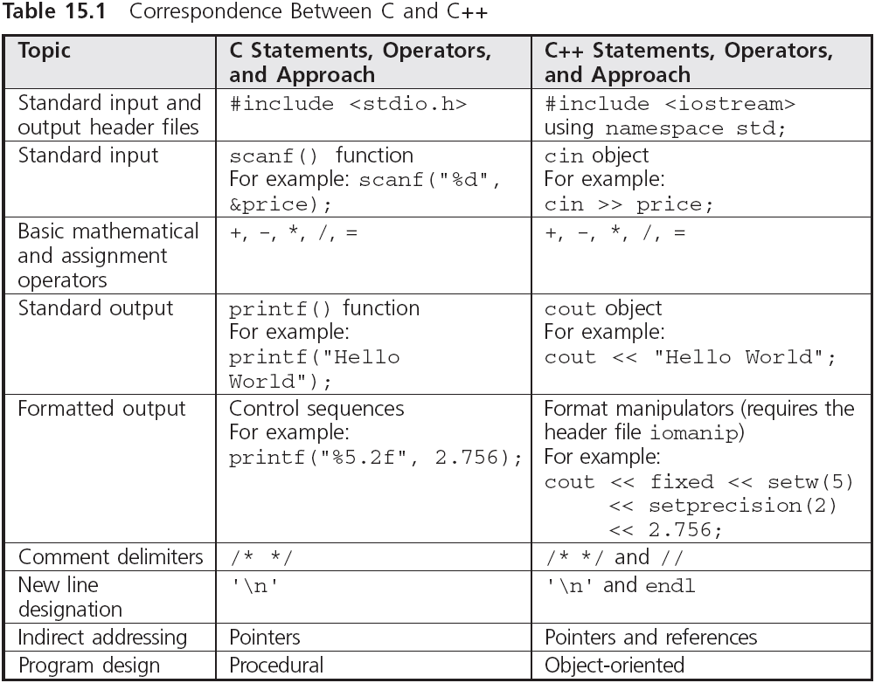
Introduction

Slide 4
Procedural Programming in C++
C is a procedural language whose statements are used to produce C functions
Such C functions can also be constructed in C++
C++ is sometimes referred to as “a better C”

Slide 5
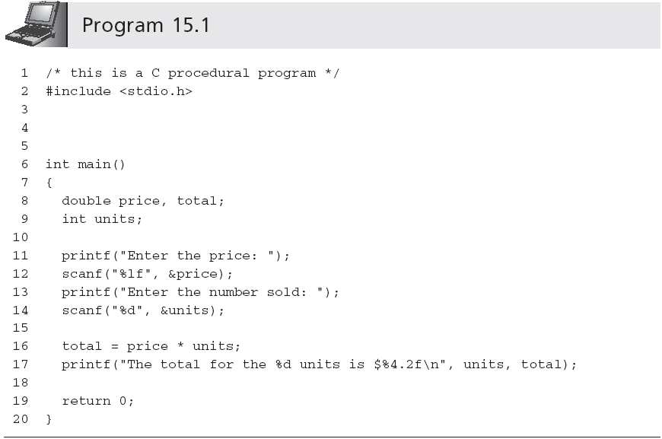
Procedural Programming in C++ (continued)

Slide 6
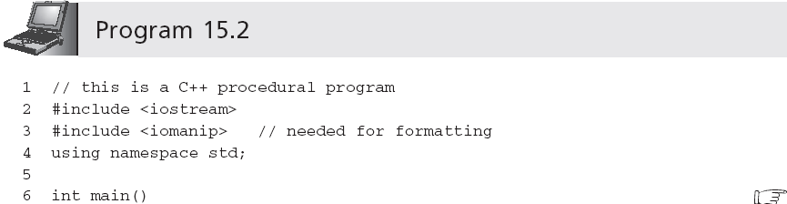
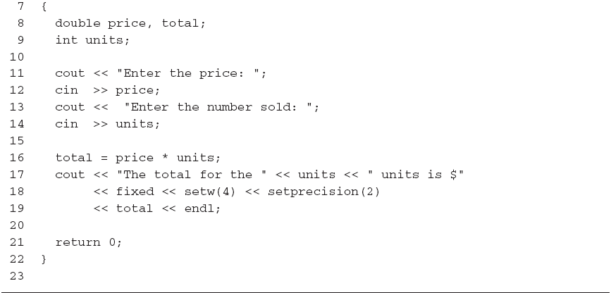
Procedural Programming in C++ (continued)
Equivalent to C’s newline sequence '\n' (which is also available in C++) followed by a flush() function call

Slide 7
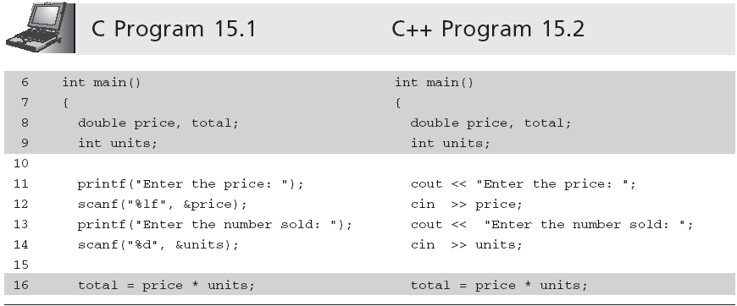
Procedural Programming in C++ (continued)

Slide 8
Object-Oriented C++
Object-oriented languages make it easier to reuse code in a manner that significantly increases software productivity
Three features are required for an OO language
Class construction
Inheritance
Polymorphism

Slide 9
Object-Oriented C++ (continued)
Class construction is the ability to create programmer-defined data types
In a programmer-defined data type, which is known as a class, the values defined for the data type can only be accessed and operated on by functions specified as part of the class

Slide 10
Object-Oriented C++ (continued)
Inheritance is the ability to derive one class from another
Permits existing code, which has been thoroughly tested, to be reused without extensive retesting
A derived class is a completely new data type
Incorporates all of the data values and operations of the original class
Adds new data and operations that create a different and expanded class
The initial class is the parent or base class
The derived class is the child or subclass

Slide 11
Object-Oriented C++ (continued)
Polymorphism permits the same operation to invoke one set of results on data values of a base class and a different set of results on data values of a derived class
Using polymorphism, existing operations on a base class can be left alone, without the need to retest and reverify them, while they are extended to a derived class
Only the extensions, rather than the complete base class, need to be tested and verified
Standard Template Library (STL)

Slide 12
Common Programming Errors
Misspelling the name of a function or C++ supplied name; for example, typing cot instead of cout
Forgetting to close a string to be displayed by cout with a double quote symbol
Forgetting to separate individual data items in a cout statement with the << symbol
Forgetting to separate individual data items in a cin statement with the >> symbol

Slide 13
Common Programming Errors (continued)
Omitting the semicolon at the end of each C++ statement
Not including the C++ header lines
#include <iostream>
using namespace std;
at the top of a C++ program

Slide 14
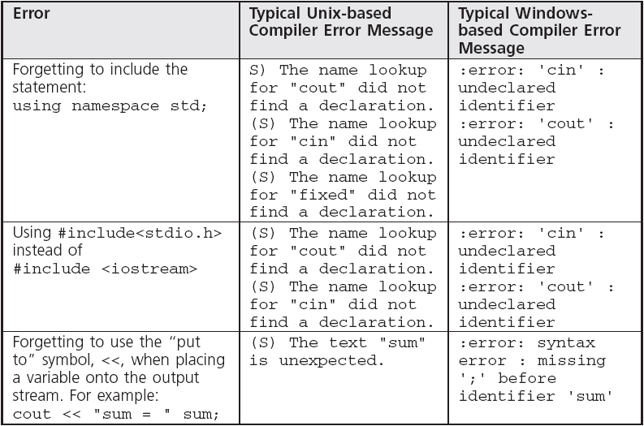
Compiler Errors

Slide 15
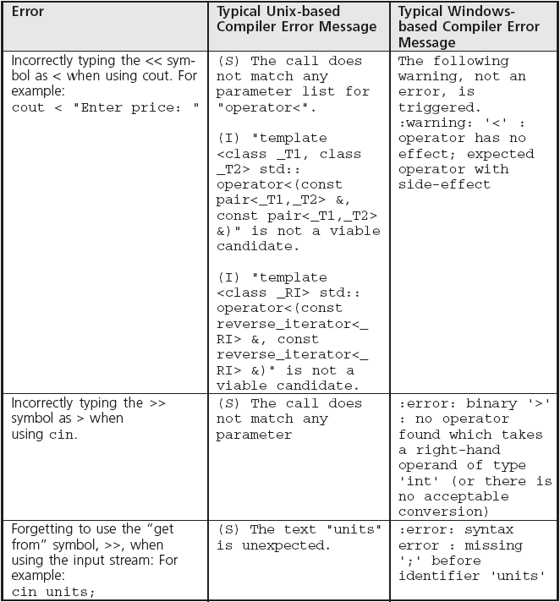
Compiler Errors (continued)

Slide 16
Summary
C++ is an object-oriented language that also supports procedural programming
Creating a C-like procedural program using C++ essentially involves changing syntax for the input and output statements
All object-oriented languages, including C++, must provide the ability to create classes and provide for inheritance and polymorphism
A class is a programmer-defined data type that includes specification of data values and operations that can be performed on these values

Slide 17
Summary (continued)
Inheritance is the ability to create a new class by extending the definition of an existing class
Polymorphism is the ability to have the same function perform different tasks depending on the class it is a member of
Every variable in a C++ program must be declared as to the type of value it can store

Slide 18
Summary (continued)
The general form of a statement using cout to display output from a C++ program is
cout << expression1 << . . . << expressionn;
The general form of a statement using cin to accept data input from the keyboard is
cin >> variable1 >> . . . >> variablen;
It is good programming practice to display a message prior to a cin statement, which alerts the user as to the type and number of data items to be entered

